Slide 1

Safeguarding training
for all school staff
September 2025
Safeguarding Education Effectiveness Advisory Team
SEA@wiltshire.gov.uk
Notes:
Whole school staff training should be delivered to all senior leaders, teaching staff, teaching assistants, pastoral and admin staff, site, cleaning and catering staff, MDSAs
Note that all the KCSiE 2025 paragraphs references in these slides were based on the draft version of the guidance published in July 2025
This training should be training supplemented by:
Prevent e-Learning – https://www.elearning.prevent.homeoffice.gov.uk/edu/screen1.html
FGM e-Learning – https://fgmelearning.vc-enable.co.uk/Register/
Cyber security – Cyber security standards: cyber security training annually for all staff with access to IT network and at least one governor (lead gov for IT) https://www.ncsc.gov.uk/information/cyber-security-training-schools
Online safety for staff – statutory annual training
From Sept 2022, governors should receive safeguarding training specific to role which should be regularly updated - Wiltshire courses or NSPCC
In Wiltshire, two courses are available:
Training for all governors
A 5-sessions programme for nominated safeguarding governors
We recommend you PRINT the notes by clicking on:
View > Notes Page
Then in Print Layout, select: Notes Page

Slide 2
Aims of this training
This training will support staff to fulfil their safeguarding responsibilities in accordance with DfE statutory guidance Working together to safeguard children and Keeping Children safe in education.
All staff will understand the importance of a child-centred approach to safeguarding and consider at all times, what is in the best interest of the child.
All staff will understand the role they play in identifying concerns, sharing information and taking prompt action.
All staff will know how to identify concerns early, provide help for children, promote children’s welfare and prevent concerns from escalating.
All staff will understand and know how to effectively follow the systems within their school or college which support safeguarding.

Slide 3

Working agreement
Listen, talk and discuss in a way that respects each individual
Everyone has a responsibility and a right to contribute
Ask questions
Look after yourself
Mobiles off/on silent
Notes:
Remind staff that anyone can be triggered by this emotive subject – take a break outside the room if needed.
(Ensure that you check in with a member of staff who leaves the room.)

Slide 4
Definition of safeguarding
Providing help and support to meet the needs of children as soon as problems emerge
Protecting children from maltreatment, whether that is within or outside the home, including online
Preventing impairment of children’s mental and physical health or development
Ensuring that children grow up in circumstances consistent with the provision of safe and effective care
Taking action to enable all children to have the best outcomes
Notes:
This is the statutory definition of safeguarding.
Point 1: providing help – education settings and staff particularly important as in a privileged position to identify and support
Point 2: protecting – child protection, protecting children from risk of harm – inc online
Point 3: preventing – ALL – universal
Point 4: ensuring – ALL - universal
Point 5: Do something – this may be short term, long term, or periods of – safeguarding continuum.
Duty of care and safeguarding | NSPCC Learning
CASPAR | NSPCC Learning

Slide 5
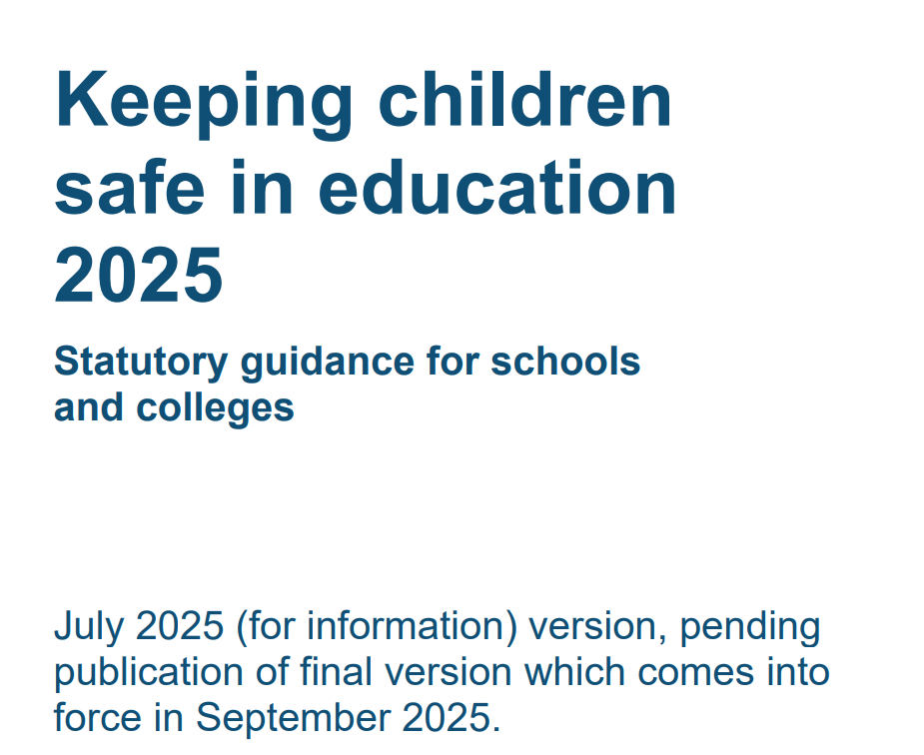
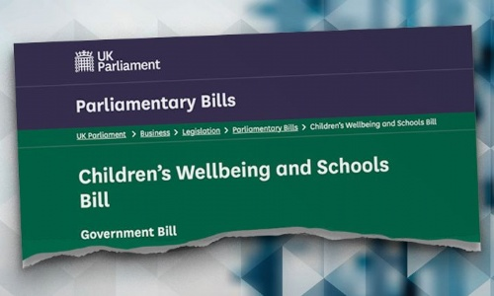
KCSiE 2025
Notes:
From Annexe F KCSiE 2025
We will publish KCSIE (final version) 2025 on 1 September 2025, by which time we
expect it to include links to revised guidance on Relationships, Sex, and Health
Education and revised guidance on gender questioning children.
KCSIE has been revised regularly for many years, and we intend that it will continue to
be revised and improved on a regular basis. Whilst there are only technical changes to
KCSIE 2025, future iterations will reflect the progress into legislation of the Children's
Wellbeing and Schools Bill, the emerging further learnings from the work of the recent
Casey Audit and subsequent inquiries, the Violence Against Women and Girls strategy
and the interactions between these advances.
This Government is clear that there are and will continue to be further learnings about
how we can better protect children in the future as we come to understand more clearly
what has gone wrong in the past and schools and colleges will continue to need to play
an incredibly important role in this.

Slide 6

The Children’s Wellbeing and Schools Bill 2025
The Children's Wellbeing and Schools bill seeks to create a more integrated and responsive system, where professionals from different agencies work together seamlessly to protect children.
This will require a significant shift in culture and practice, but it has the potential to make a real difference in the lives of vulnerable children.
Notes:
It is worth signposting to your staff that the bill is expected to pass into law (and is one reason for a delay to more wide-ranging changes/updates to KCSiE pending this) and that it represents a significant shift in safeguarding practices in England. It mandates that schools are integral partners in local authority arrangements (not statutory).

Slide 7
KCSiE 2025 changes
Part one – Safeguarding information for all staff (no changes made)
Para 128 - We have added a note to say that we expect to publish revised guidance on Relationships, Sex, and Health Education this summer. If published, we will signpost to this guidance in September 2025.
Para 135 - Updated to clarify misinformation, disinformation and conspiracy theories are safeguarding harms. (covered later in this presentation).
Para 204 - We have added a note to say that we expect to publish the revised guidance on gender questioning children this summer. If published, we will signpost to this guidance in September 2025.
Notes:
Mostly technical changes and DSLs should read Annexe F for all the changes. Included on these slides are the changes that staff should be aware of. Note that where there have not been changes the paragraph numbers may have changed and this would need to be reflected in any policy that references KCSiE.

Slide 8
Reporting & Recording: Our Systems and Processes
KCSiE para 66:
Record keeping
All concerns, discussions and decisions made, and the reasons for those decisions, should be recorded in writing. This will also help if/when responding to any complaints about the way a case has been handled by the school or college. Information should be kept confidential and stored securely. It is good practice to keep concerns and referrals in a separate child protection file for each child.
Records should include:
a clear and comprehensive summary of the concern
• details of how the concern was followed up and resolved, and
• a note of any action taken, decisions reached and the outcome.
Notes:
#Note to DSL a separate training PPT is available for staff training that covers high quality record keeping/GDPR/Info sharing that can be used later in the term/year to support this.
1. So, what and how do we record?
We record everything that gives us cause for concern and we must discuss with the child’s parents. The only time that we do not do this is when it might put the child in danger/risk of significant harm.
Recording keeping is really important ie ensure all records:
include a clear and comprehensive summary of the concern detailed, including dates / year
are objective – they ought to be able to make sense to a judge for example – avoid using jargon or acronyms that may mean something different to someone from another agency ‘I will speak with PSA / Jenny’
should always be first-hand rather than written by the DSL on behalf of a teacher.
Protocol for reporting- stick to fact and NEVER:
Assumptions
Hearsay
Speculations
Your own emotions
However it is important that ‘gut feelings’ are shared, acknowledged and explored with school’s DSL. They are different from assumptions and it is the role of case discussion to evidence impact to child of concern. These need to be documented as change of worker can risk these concerns being lost.
Be very specific: for example ‘the house had poor conditions’ does not tell you as much as ‘the house was unsanitary with a foul smell and a fire hazard’. The DSL should not have to read between the lines of a concern. Families are told about the CP policy and know that staff have a duty to report concerns, some of which will lead to referrals to outside agencies and some that won’t.
The child’s wishes also need to be recorded and taken into account when action is being considered. Highlight these parts on the concern form.
2. So, when do we report a concern to the D/DSL?
Any safeguarding concern must be reported in writing and referred to the DSL on the same day.
Actions:
Most concerns have associated actions for the person reporting the concern. Eg ‘I spoke to the parent who said...’ or ‘I asked the child about the argument and he said…’ (TED)
Some actions will require follow up from the DSL
Follow up:
Explain/discuss why this is important – the person raising the concern will remain concerned until they are satisfied that appropriate action has been taken. Our role is to seek an outcome for the child.
Any concerns raised that might meet the threshold of significant harm must be reported immediately to a DSL and the person raising the concern should expect to know the outcome the same working day (before the child is sent home) whenever possible.
UNLIKELY BUT ALL STAFF MUST BE READY TO MAKE A REQUEST FOR SERVICE TO IFD IN THE ABSENCE OF A DSL
Important: Professional Challenge (case resolution):
If the DSL decides not to make a request for service to IFD and the member of staff believes that the child is at risk then they must have the opportunity to discuss this with the DSL to professionally disagree until they have reached a consensus. If they cannot agree, the person raising the concern should know who next to speak to, safeguarding governor or to contact IFD directly for advice. Are the contact details readily available?
Reference Wiltshire case resolution protocol – important aspect of culture of safeguarding at the school.
We must be confident to stand by our concerns. We do not have to know for certain whether something has/is happening before reporting that we are concerned that it might have/be. ‘I am concerned that Evie may not be getting enough to eat…or that she is hearing/seeing parental arguments at home that are distressing for her...’ A report that you are concerned is just that and may be enough on it’s own to warrant additional support for a child or form part of a bigger picture of issues/needs.
3. What will happen next:
The DSL will look at the bigger picture and piece together any other concerns. Sometimes that one concern is enough to call IFD.
The DSL can use ‘professional consultation’ with IFD at any time without giving the child’s name.
Sometimes IFD will ask for a referral (for Early Help or child in need of support or at risk/having suffered significant harm)
Referrals must be written on the official notification form.
Generally, it is the role of the DSL to ask for additional external support via a referral to another agency – although you may need to complete a referral in the absence of the DSL
Social care leads the process for deciding about this but that any member of staff may need to contribute to an assessment or support plan.
Flowcharts in school show how this happens.
Explain to the staff how you categorise concerns within your recording system in your setting, in particular child-on-child abuse.

Slide 9


What do we need to record?
Incident or concern reports and body maps
Child protection plans and notes from meetings
Safeguarding related risk assessments
Meeting minutes
Communication logs (parents and external logs)
Staff training records
Information from audits and reviews.
Notes:
What adds to our understanding of the child and their lives?
What are the identified risks or protective factors – what needs to happen next?
Risk assessments recorded, risks and measure to mitigate.
Meetings – dates, times, locations and attendees. What actions and by whom?
Communication logs with parents/carers and other agencies.
Chronology – does the record read like a ‘story’
Audit trail to support assessment of decision making – oversight by HT/safeguarding governor, self reflection - team reviews.

Slide 10
What to expect when you report a concern/role of DSL
The Designated Safeguarding Lead will:
Acknowledge concern.
Carry out statutory duties of the DSL role
Provide you with feedback; it is your responsibility to request feedback if not given.
Provide the opportunity to professionally challenge.
Maintain detailed, accurate, secure records of all concerns, discussion and decisions made including the rationale for those decisions.
Record clear action and review of actions and outcome.
Identify early intervention support and/or referral to support agencies/services.
Work in partnership with parents/carers and external multi-agencies.
Provide you with any further support or training needed.

Slide 11
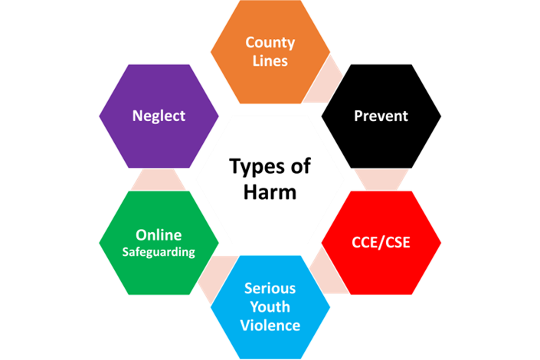
Abuse and Harm
Notes:
Part 2

Slide 12

What is Child Abuse?
Physical abuse
Neglect
Emotional abuse
Sexual abuse
Risk outside the home
ROTH
‘It can and does happen here’
Notes:
Explain what the 4 categories of abuse are – ROTH mention this will be discussed later in the training. Wiltshire recognize ROTH as a 5th form of abuse at child protection level. (If time and you wish this can be an interactive discussion).
https://www.met.police.uk/advice/advice-and-information/caa/child-abuse/what-is-child-abuse/
Notes for DSLs
Smacking – as a ‘reasonable form of chastisement’ is an accepted defense in law but may not involve use of a belt, strap or other instrument or leave marks as this would constitute abuse. Note: illegal in Wales and Scotland.
Safeguarding issues – All staff should have an awareness of safeguarding issues that can put children at risk of harm. Annex B contains important information about specific forms of abuse and s/g issues and anyone who work directly with children should read it.
What signs may you see that a child is at risk? Acknowledge how some signs of abuse are more visible than others; there are different degrees of severity, some happen in a continuum, yet all constitute abuse.
We have a duty to challenge signs of neglect. Cycle of neglect over time, from one generation to another. This is why sharing concerns is so important and thinking of the context for that child; building jigsaw puzzle pieces to form whole picture. What is the experience of this child? We must not allow acts of omission to continue un-checked.
As staff we need to be mindful:
How easy it can be to ignore or minimise the persistent signs as/if individually they resonate with our own (not persistent) experiences? – healthy to challenge unconscious bias.
The fact that it is evident that parents love their children too can cloud the issue. Neglect by parents is very often nothing to do with lack of love for their children.

Slide 13
KCSiE 2025: Abuse, neglect and exploitation
Para 19: All staff should be aware of the indicators of abuse, neglect and exploitation, understanding that children can be at risk of harm inside and outside of the school/college, inside and outside of home and online. Exercising professional curiosity and knowing what to look for is vital for the early identification of abuse and neglect so that staff are able to identify cases of children who may be in need of help or protection.
Para 20: All school and college staff should be aware that abuse, neglect, exploitation, and safeguarding issues are rarely standalone events and cannot be covered by one definition or one label alone. In most cases, multiple issues will overlap.
Notes:
Explain the statutory duty of all school staff and that safeguarding is everyone’s responsibility.

Slide 14
What do we mean by ‘Significant Harm’?
It is:
ill-treatment or impairment of health or development including for example impairment suffered from seeing or hearing the ill-treatment of another;
As a result of:
a single traumatic event
witnessing domestic violence or an awareness of domestic violence within their home environment
the cumulative effect of significant events, both acute and long-standing, or
the damaging impact of neglect which interrupt and change or damage the child's physical and psychological development.
Notes:
The Children Act 1989 introduced Significant Harm as the threshold that justifies compulsory intervention in family life in the best interest of children.
Although there is no absolute criteria for determining whether or not harm is “significant”, local authorities such as social services, police, education and health agencies work with family members to assess the child, and a decision is made based on their professional judgement using the gathered evidence.
Any concerns raised that might meet the threshold of significant harm must be reported immediately to a DSL and the person raising the concern should expect to know the outcome the same working day (before the child is sent home) whenever possible.
Harm can be determined “significant” by “comparing a child’s health and development with what might be reasonably expected of a similar child”.
This includes harm that occurs inside or outside the home, including online.

Slide 15
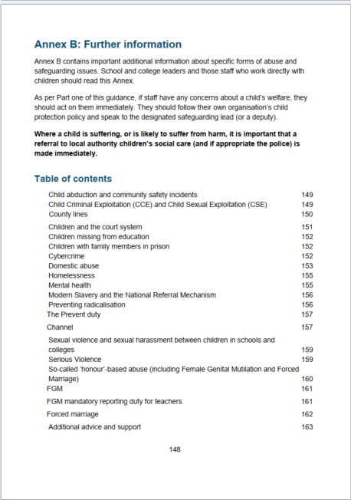
Recognising abuse, neglect, exploitation and safeguarding issues: KCSiE Annexe B
Child abuse
Child-on-child abuse
SVSH - HSB
Child Criminal and Sexual Exploitation – Risk outside of the Home
Female Genital Mutilation
Forced Marriage
Domestic abuse
Radicalisation and Extremism
Mental health
Online Safety
Notes:
DSL to remind staff in regulated activity to read and understand KCSiE 2025 Annexe B which details safeguarding issues are explained in detail in Annex B and explain specific training around these areas will be delivered during the year.

Slide 16

Contextual Safeguarding: Why we need to understand the lived experience of our children and young people.
KCSiE para 29: All staff should have an awareness of safeguarding issues that can put children at risk of harm. Behaviours linked to issues such as drug taking and/or alcohol misuse, unexplainable and/or persistent absences from education, serious violence (including that linked to county lines), radicalization and consensual and non-consensual sharing of nude and semi-nude images and/or videos, can be signs that children are at risk.
Working Together to safeguard children – harm outside the home
Practitioners should consider the needs, experiences and vulnerabilities of the individuals or groups who are experiencing , or are at risk of experiencing, harm outside the home – including criminal exploitation, sexual exploitation or serious violence.
Notes:
DSL to explain contextual safeguarding approach:
All staff should have an awareness of wider safeguarding issues that can put children at risk of harm as discussed in previous slides
All staff should be aware that children being absent from school or college, particularly repeatedly and/or for prolonged periods, and children missing education can act as a vital warning sign of a range of safeguarding possibilities.
eg exploitation, behaviours linked with drug/alcohol abuse, missing education, sexting / online abuse, experiencing Adverse Childhood Experiences (eg parental alcohol/drug misuse, parental mental health issues, DA) staff need to understand that children can be at risk of harm inside and outside of the school/college, inside and outside of home and online. Exercising professional curiosity and knowing what to look for is vital for the early identification of abuse and neglect.
The dynamics of adolescence increases risk: emotional regulation, increasing desire for autonomy, risk and motivation for ‘thrills’ and short-term gains. Adolescents will spend increasingly amounts of time outside the home and may experience violence and abuse in these public environments.
A young person’s peer group can be more influential when it comes to setting standards of what is normal.
It is down to schools to consider the risks within the local community (mapping) and be alert.

Slide 17
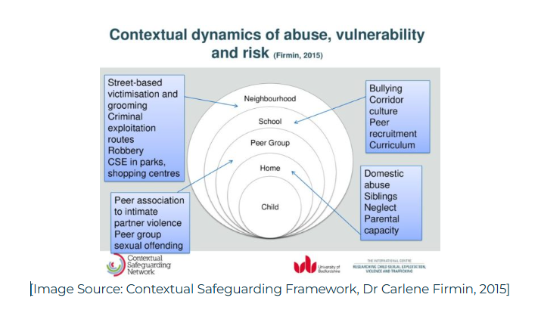
What factors put our children and young people at risk?
Extra Familial Harm
Notes:
Contextual safeguarding in government policy
Contextual safeguarding is referenced in the government’s guidance ‘Working Together to Safeguard Children’ and ‘Keeping Children Safe in Education’, or ‘KCSIE’, acknowledging that abuse in extra-familial contexts creates child protection issues and that environmental factors linked to this kind of abuse should be addressed.
Contextual safeguarding is an approach to understanding, and responding to, young people’s experiences in a range of social contexts, and ultimately expanding child protection system objectives beyond their families, to recognise young people are vulnerable to significant harm in these areas.
The contextual safeguarding framework was developed by Dr. Carlene Firmin at the University of Bedfordshire. It recognises that as a child or young person grows, the range of environments and the number of people outside of their family expands. This included within educational environments such as school or college, in their groups of friends, within the community and local area where they live, and even online.
Children and young people can encounter risk in any or all of these different environments and/or with these additional individuals in their life. When these environments and groups of people overlap, there might even be multiple risks. This is often called extra familial abuse.
The risk can vary, depending on the area in which the young person lives or socialises. In areas with a lot of problems surrounding gang culture, gun and knife crime might be a key safeguarding issue. We also know that young people communicate largely through social media, which can leave them unknowingly exposed to the risks of online grooming and harmful content.
What signs may we see to indicate these risks?
For example:
unexplained changes in behaviour or personality
becoming withdrawn
becoming uncharacteristically aggressive
seeming anxious
lacks social skills and has few friends, if any
poor bond or relationship with a parent
knowledge of adult issues inappropriate for their age
running away or going missing – from home, care, education
always choosing to wear clothes which cover their body.

Slide 18
Child Criminal Exploitation Child Sexual Exploitation Online Safety Domestic Abuse Prevent Duty
Notes:
Part 4

Slide 19
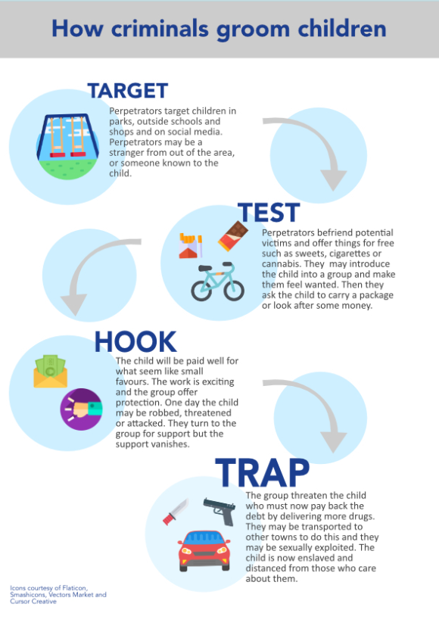
Child Criminal Exploitation How criminals groom children
escapeline.org.uk/fact-sheet/
Notes:
The 4 stages of CCE. Once criminals have got a young people to the hook stage it can be almost impossible to break the cycle. This is why early identification of the signs of potential grooming are vital in protecting and preventing children and young people becoming exploited by criminal gangs.

Slide 20
Children who are absent from education
KCSiE 2025 Para 177.
Children being absent from education for prolonged periods and/or on repeat
occasions can act as a vital warning sign to a range of safeguarding issues
including neglect, child sexual and child criminal exploitation - particularly county lines.
Working together to improve school attendance DfE guidance
now statutory guidance
Notes:
Explain the importance of absence procedures in the you safeguarding duty. Support staff understanding that all children and young people are potentially vulnerable to CCE and CSE regardless of their home circumstances and background and why vigilance is required around changes in behaviour and unexplained absence.

Slide 21
Children with increased vulnerabilities and at greater risk of harm
It is important we understand the factors that may increase a child's vulnerability to abuse or neglect or susceptibility to radicalisation and why.
Children and young people
With identified SEND or certain health conditions
Who are LGBT+
Who are experiencing mental health problems
Children looked after, previously looked after (CLA/PLAC)
Absent from education
Note this list is not exhaustive, staff are required to maintain a vigilance with all children and young people and report concerns where a vulnerability increases.
Notes:
“What are the factors that may increase a child's vulnerability to abuse or neglect or susceptibility to radicalisation? And why?”
1. Children with (SEND) or certain health conditions can face additional safeguarding challenges both online and offline.
Explain how children with SEND are more vulnerable in terms of safeguarding, as they may:
not have the language to share concerns or cognitive ability to understand what is happening (more though not exclusively vulnerable to grooming if lower cognitive ability)
live in families under increased pressure, emotionally, physically, financially
be more isolated from protective factors of most peers
rely on intimate care – increased risk of physical/sexual abuse.
Additional barriers can exist when recognising abuse and neglect in this group of children. These can include:
assumptions that indicators of possible abuse such as behaviour, mood and injury relate to the child’s condition without further exploration;
these children being more prone to peer group isolation or bullying (including prejudice-based bullying) than other children;
communication barriers and difficulties in managing or reporting these challenges; and
cognitive understanding – being unable to understand the difference between fact and fiction in online content and then repeating the content/behaviours in schools or colleges or the consequences of doing so
Hence the need for colleagues to share information about a child’s SEND.
2. Children who are lesbian, gay, bi, or trans (LGBT) –
The fact that a child or a young person may be LGBT is not in itself an inherent risk factor for harm. However, children who are LGBT can be targeted by other children. In some cases, a child who is perceived by other children to be LGBT (whether they are or not) can be just as vulnerable as children who identify as LGBT.
Risks can be compounded where children who are LGBT lack a trusted adult with whom they can be open. It is therefore vital that staff endeavour to reduce the additional barriers faced, and create a safe culture for them to speak out or share their concerns with members of staff.
Describe what we do in our school to support children who are LGBT ie:
LGBT inclusion forms part of our RSHE curriculum
pastoral support available [describe who the trusted adults are in the school, and what is the safe place for them to share their concerns]
procedures to help counter homophobic, biphobic and transphobic bullying and abuse etc.
3. Mental health problems can, in some case, be an indicator that a child has suffered or is at risk of suffering abuse, neglect or exploitation.
4. Looked after children and previously looked after children may enter care for all sorts of reasons. But many enter because they have been abused or neglected. These experiences can leave children with complex emotional and mental health needs, which can increase their vulnerability to abuse.
5. Children who are absent from education, particularly persistently, can act as a vital warning sign to a range of safeguarding issues including neglect, child sexual and child criminal exploitation- particularly county lines. It is important that our school’s response to children absent and missing from education supports identifying such abuse and helps prevent the risk of them going missing in the future.
Remind all staff your school’s response to children absent from and missing from education, including when problems are first emerging but also where children are already known to children’s social care and need a social worker (such as a child with a CIN or CP plan, or a looked after child), where going missing from education may increase known safeguarding risks within the family or in the community. Missing education will also impact on educational outcomes. We should continue to have high aspirations for these children and be mindful of Educational neglect.
This list isn’t exhaustive.

Slide 22
Female Genital Mutilation (FGM)
KCSiE 2025 para 42:
Whilst all staff should speak to the DSL or DDSL with regard to any concerns about FGM, there is a specific legal duty on teachers. If a teacher, in the course of their work in the profession, discovers that an act of FGM appears to have been carried out on a girl under the age of 18, the teacher must report this to the police.
This mandatory reporting duty was placed on teachers since 31 October 2015.
FGM comprises all procedures involving partial or total removal of the external female genitalia or other injury to the female genital organs. It is illegal in the UK and a form of child abuse with long-lasting harmful consequences.
Notes:
DSL read: Discovers: it will be rare for teachers to see visual evidence, and they should not be examining pupils/students, but the same definition of what is meant by ‘to discover that an act of FGM appears to have been carried out’ is used for all professionals to whom this mandatory reporting duty applies.
E-learning: Recognising and preventing FGM training gives an introduction to FGM and the action you must take to protect girls who may be at risk
KCSiE 2025 para 130: The safeguarding curriculum – RSHE/PSHE should be fully inclusive and developed to be age and stage of development appropriate. This programme will include issues such as:
the concepts of, and laws relating to – sexual consent, sexual exploitation, abuse, grooming, coercion, harassment, rape, domestic abuse, so-called ‘honour’-base violence such as forced marriage and FGM, and how to access support

Slide 23

Domestic abuse
All children can witness and be adversely affected by domestic abuse in the context of their home life where domestic abuse occurs between family member. Many children who experience domestic abuse are missed.
Signs of exposure to DA may include:
The development of mental health problems
Difficulty sleeping
Lower attainment
Difficulty regulation their emotions
Self-harm
Substance use
Refuge runs the National Domestic Abuse Helpline,
24 hours a day on 0808 2000 247.
Operation Encompass
Notes:
Experiencing domestic abuse can have a serious, long lasting emotional and psychological impact on children. In some cases, a child may blame themselves for the abuse or may have had to leave the family home as a result.
Young people can also experience domestic abuse within their own intimate relationships. This form of child-on-child abuse is sometimes referred to as ‘teenage relationship abuse.
Explain Operation Encompass
Operation Encompass provides an advice and helpline service for all staff members from educational settings who may be concerned about children who have experienced domestic abuse. The helpline is available 8:00 to 13:00, Monday to Friday on 0204 513 9990
KCSiE 2025 Pgs 154-156

Slide 24
Online safety and cyber security requirements
KCSiE 2025 para 135. The breadth of issues classified within online safety is considerable and ever
evolving, but can be categorised into four areas of risk:
content: being exposed to illegal, inappropriate, or harmful content, for example: pornography, racism, misogyny, self-harm, suicide, anti-Semitism, radicalisation, extremism, misinformation, disinformation (including fake news) and conspiracy theories.
contact: being subjected to harmful online interaction with other users; for example: peer to peer pressure, commercial advertising and adults posing as children or young adults with the intention to groom or exploit them for sexual, criminal, financial or other purposes.
conduct: online behaviour that increases the likelihood of, or causes, harm; for example, making, sending and receiving explicit images (e.g. consensual and non-consensual sharing of nudes and semi-nudes and/or pornography, sharing other explicit images and online bullying, and
commerce: risks such as online gambling, inappropriate advertising, phishing and or financial scams. If you feel your pupils, students or staff are at risk, please report it to the Anti-Phishing Working Group
SWGfL
Notes:
DSL to tell staff where to find the school’s Online safety policy and of the annual requirement to complete training ( it not currently mandatory to have a separate policy but is considered good practice, but this should be included in the safeguarding policy if not) and their responsibilities in this and when online safety training will happen and to complete cyber security training.
The Department for Science, Innovation and Technology (DSIT) recently released the Cyber Security Breaches Survey 2024, highlighting that 71% of secondary schools experienced a cyber breach or attack in the past year, in contrast to 52% of primary schools. Phishing remains the most frequent type of cyber breach within educational institutions with the survey showing that 92% of primary schools and 89% of secondary schools reported encountering phishing attempts.

Slide 25
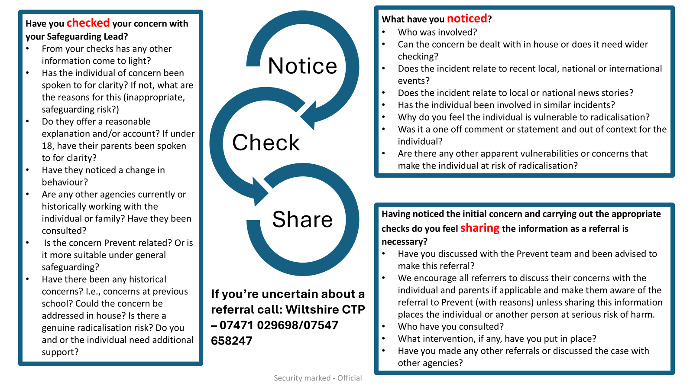
Notes:
Note to DSL – you may choose to share this with staff, display in your setting and follow up in a future briefing.
Please also remember the principles of Notice, Check, Share
NOTICE the change in behaviour, use of language or other Prevent related concerns.
CHECK your concern with the Designated Safeguarding Lead
SHARE your concerns with Counter Terrorism Policing by submitting a referral - remembering to submit as much detail as possible taking note of the prompts on the referral form to allow the police to make an accurate assessment.

Slide 26
Listening to our children and young people
Notes:
Part 5

Slide 27
The voices of our children
All staff should be aware that children may not feel ready or know how to tell someone that they are being abused, exploited, or neglected, and/or they may not recognise their experiences as harmful.
This should not prevent staff from having a professional curiosity and speaking to the DSL if they have concerns about a child. It is also important that staff determine how best to build trusted relationships with children and young people which facilitate communication.
Reviews of serious incidents have highlighted that children often do not feel able to tell adults and professionals what is happening to them. This is either through a lack of trust in adults, fear and intimidation or not having the words.
It should not be the child’s responsibility to tell professionals when they are being abused. It is the responsibility of the professionals to collect and weigh up the evidence and make a professional judgement about the likely risk of abuse.
Information sharing DfE guidance
Notes:
What opportunities and time do we have to build authentic relationships? – what does a trusted relationship look like?
If we have a responsibility to identify and not just respond to issues, how do we know what is normal for our children to be able to determine when something abnormal is happening? Remember children do not always know that they are experiencing neglect or abuse and so we must be better at identifying it.
To safeguard and to identify issues early, very importantly, there is a need for problem-free talk during start end of class time, corridor chat. Key that staff don’t always appear too busy. Lunch and break times? How does problem free talk fit with your role?
2. What questions do we ask that show we are interested?
TED often used as a tool when a child makes a disclosure to prevent asking leading questions and this is important in legal cases to be sure a child hasn’t been led or coached into making the disclosure. More widely, TED is a good way generally to ask open questions:
Tell – ‘How was your weekend? (not Did you have a lovely weekend? - expectation is that a child should say ‘yes’ and not want to disappoint if the real answer is ‘no’) Tell me what me what happened to your knee (not ‘what did you do to your knee?’)
Explain – ‘You had a surprise present from your aunt – explain the surprise to me? Who gets to know?’ eg special present of a phone from an aunt – something a child is excited about might be a concern for you if the phone is for exclusive use between the aunt and the child.
Describe - ‘So you play games at the weekend ? Describe how that works. Who plays? How does it go?’
3. What information do we share about them with colleagues?
GDPR – has led some to be concerned that they cannot share sensitive information about a child. Stress that we must (and can) share information within school when it will safeguard the child/ young person. All school staff are bound by rules of confidentiality around the school ie not shared outside school or for any purpose within school other than in the best interests of the child. If in doubt, always share. We also must also be prepared to hear/know information about a child that we find hard to hear.
One of the seven golden rules is that information you share must be Necessary, proportionate, relevant, accurate, timely and secure. Information sharing DfE guidance
This is covered in the separate Record Keeping PPT.
KCSiE 2025 makes numerous reference to the importance of information sharing.
All staff dealing directly with children need to know the existing issues for children.
Question to delegates: How is such information shared in our school?
4. What has this got to do with safeguarding?
Knowing our children is a key way to ensure we are able to represent the voice of the child. The voice of the child is not just by recording in writing word for word what a child says if making a specific disclosure of abuse.
Note as professionals we sometimes want to speak on behalf of the child and to teach or explain something to them even before we have taken time to listen to them. It is important to take ‘one-down’ position.

Slide 28
Children have said they need
Vigilance: to have adults notice when things are troubling them
Understanding and action: to understand what is happening; to be heard and understood; and to have than understanding acted upon
Stability: to be able to develop an ongoing stable relationship of trust with those helping them
Respect: to be treated with the expectation that they are competent rather than not
Information and engagement: to be informed about and involved in procedures, decisions, concerns and plans
Explanation: to be informed of the outcome of assessments and decisions and reasons when their views have not be met with a positive response
Support: to be provided with support in their own right as well as a member of their family
Advocacy: to be provided with advocacy to assist them in putting forward their views
Protection: to be protected against all forms of abuse

Slide 29
The impact of language (from Barnados 2024 Review)
The language we use to describe children, and their experience/s should:
Inspire children
Evoke hope in a child
Help a child make sense of their identity
Empower children
Reflect their identity
quality of interventions offered to children
Barnardos Language Matters
NSPCC Why language matters
However, it can also:
Silence a child who had something to tell
Blame a child for something they had no control over
Oppress a child who expresses themselves for who they are
Shame a child who was seeking help
Influence the level and quality of interventions offered to children
Notes:
Barnardos Language Matters

Slide 30
Who presents a risk to
children and young people?
Notes:
Part 7
Warning next slide includes news reports of abuse cases. These have all been in the news in 2025. You may wish to use some or all as examples of the importance of professional curiosity and vigilance.

Slide 31
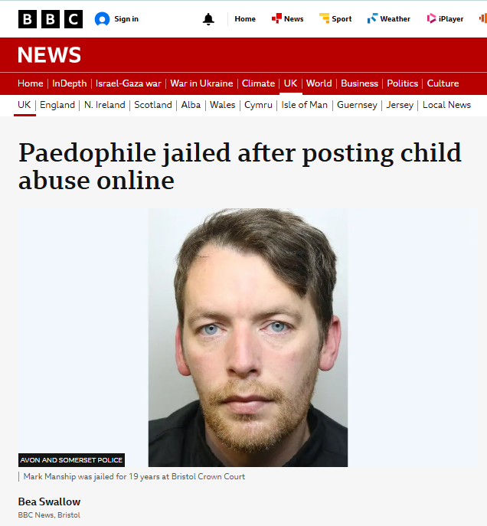
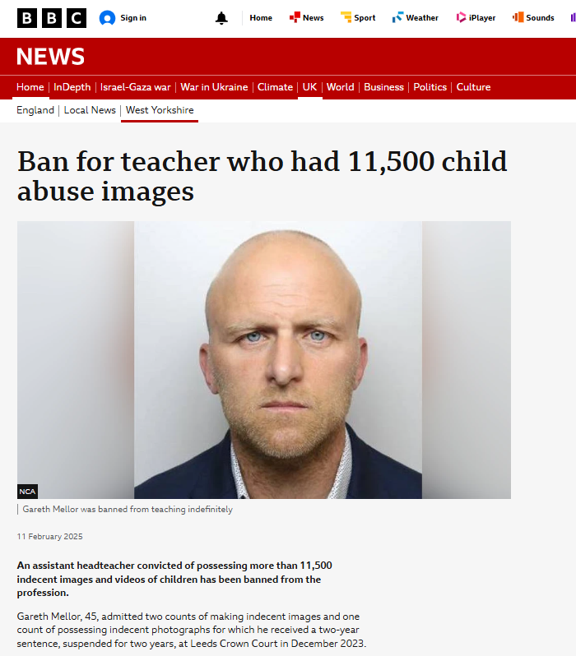
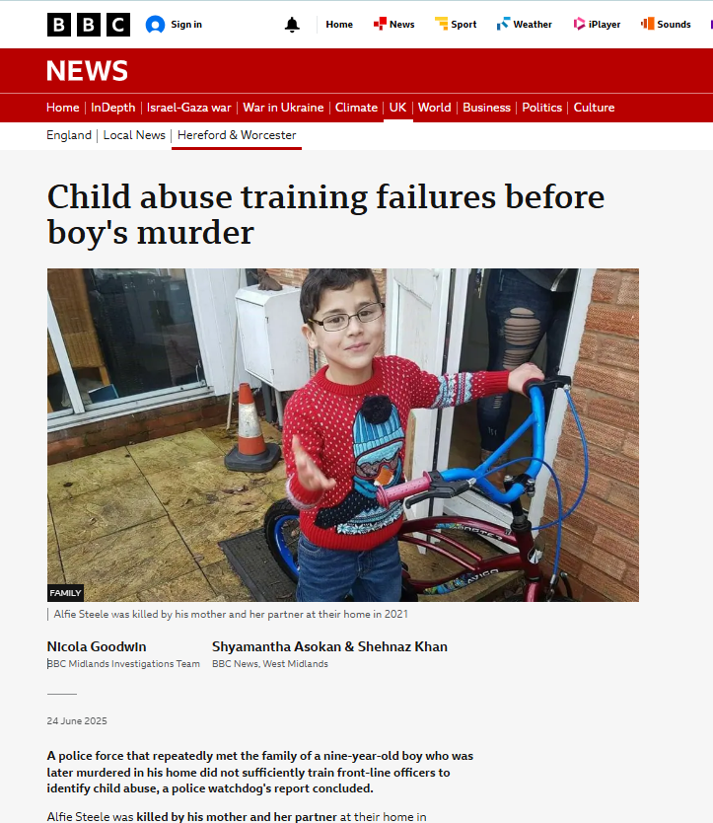
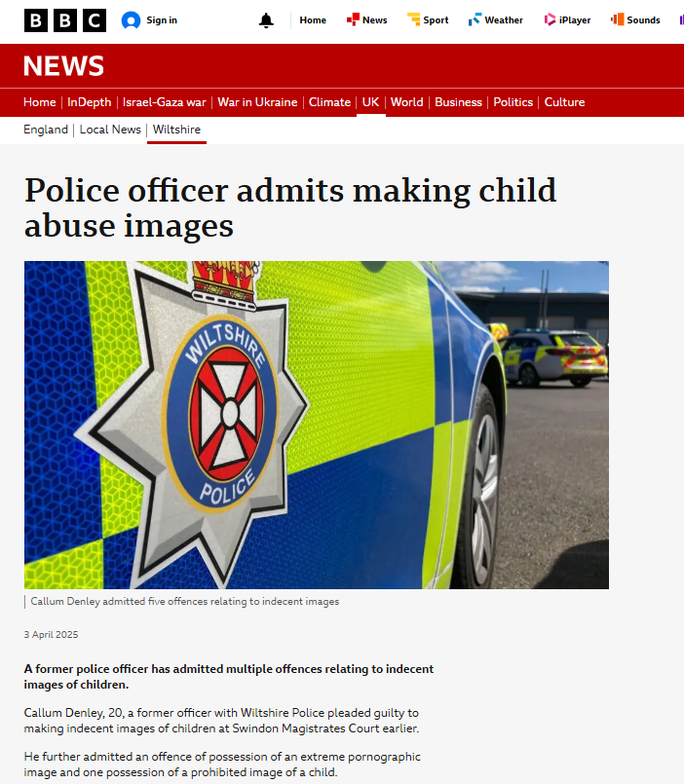
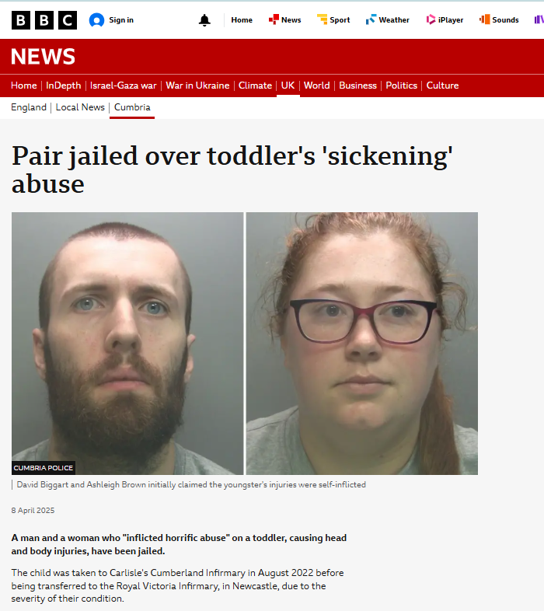
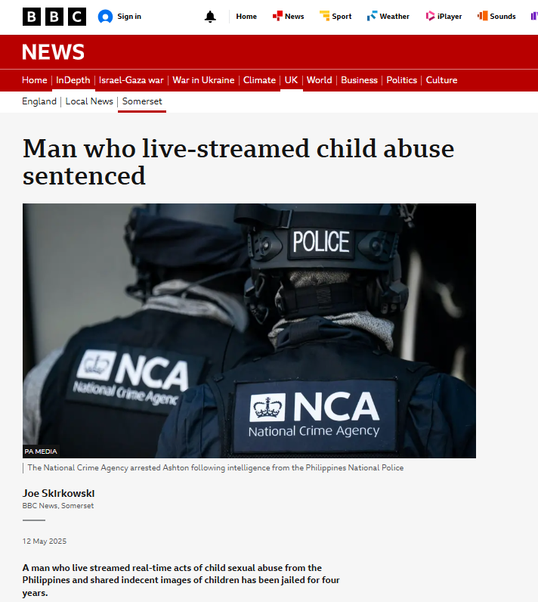
Notes:
1. 27 June 2025
A paedophile who committed a string of "revolting" sexual offences against children has been jailed for 19 years.
Mark Manship, 39, of Cardiff, was convicted of raping, sexually assaulting and sharing indecent images of a young girl from Bristol online.
During sentencing at Bristol Crown Court on Friday, he was made subject to a lifelong Sexual Harm Prevention Order, restraining orders and was added to the sex offenders register.
Det Con Elizabeth Howell described Manship as a "manipulative man who committed truly abhorrent crimes to fuel his own grotesque sexual desires".
2. 24 June 2025
A police force that repeatedly met the family of a nine-year-old boy who was later murdered in his home did not sufficiently train front-line officers to identify child abuse, a police watchdog's report concluded.
Alfie Steele was killed by his mother and her partner at their home in Droitwich, Worcestershire, in 2021 and the pair were jailed two years later. The nine-year-old was subjected to months of abuse and died after being held under the water in the bath at his home in February 2021.
He had endured years of abuse and had more than 50 injuries on his body at the time of his death.
Alfie's mother, Carla Scott was jailed for manslaughter, while her partner, Dirk Howell was sentenced to at least 32 years in prison for murder in June 2023.
3. 12 May 2025
A man who live streamed real-time acts of child sexual abuse from the Philippines and shared indecent images of children has been jailed for four years.
Darren Ashton, from Washford in Somerset, regularly accessed the websites and discussed the sharing of images and videos of male children aged 13 and 14.
National Crime Agency (NCA) officers arrested Ashton, 52, at his home following intelligence from the National Bureau of Investigation in the Philippines.
"Ashton was abusing children over the internet, encouraging them to send images and videos, and watching live streamed and real time child sexual abuse from the Philippines," said NCA operations manager, Danielle Pownall.
4. 3 April 2025
A former police officer has admitted multiple offences relating to indecent images of children.
Callum Denley, 20, a former officer with Wiltshire Police pleaded guilty to making indecent images of children at Swindon Magistrates Court earlier.
He further admitted an offence of possession of an extreme pornographic image and one possession of a prohibited image of a child.
He was due to be sentenced at Swindon Crown Court on 2 May.
The offences covered category A images, the most serious abuse material, Wiltshire Police said.
5. 11 February 2025
An assistant headteacher convicted of possessing more than 11,500 indecent images and videos of children has been banned from the profession.
Gareth Mellor, 45, admitted two counts of making indecent images and one count of possessing indecent photographs for which he received a two-year sentence, suspended for two years, at Leeds Crown Court in December 2023.
According to the National Crime Agency (NCA), Mellor had worked at Kettlethorpe High School in Wakefield but none of his offending, which took place between 2014 and 2021, had involved his pupils.
Following a Teaching Regulation Agency (TRA) hearing last month, Mellor, formerly of Pennycroft Road, Uttoxeter, was told he would never teach again.
The panel was told Mellor had also been the designated safeguarding lead at the school and the pastoral lead for 320 students.
The NCA said he had paid for indecent images of children via an encrypted cloud storage service, leading to his arrest at his Staffordshire home in May 2021.
6. 8 April 2025
A man and a woman who "inflicted horrific abuse" on a toddler, causing head and body injuries, have been jailed.
The child was taken to Carlisle's Cumberland Infirmary in August 2022 before being transferred to the Royal Victoria Infirmary, in Newcastle, due to the severity of their condition.
David Biggart and Ashleigh Brown pleaded guilty to causing or allowing a child to suffer serious physical harm.
At Carlisle Crown Court, Biggart, 30, was sentenced to nine years and four months while Brown, 31, was imprisoned for two years and seven months.
Cumbria Police said it had been contacted by medical staff over concerns about the nature of the youngster's injuries and Biggart, whose address in court was given as Aidrie, Lanarkshire, and Brown, of Marks Avenue, Carlisle, were arrested on suspicion of child neglect.
When questioned, both attempted to suggest the injuries were self-inflicted.

Slide 32
Harms threshold and low-level concern
Harms threshold:
Behaved in a way that has harmed a child, or may have harmed a child and/or
Possibly committed a criminal offence against or related to a child, and/or
Behaved towards a child or children in a way that indicates he or she may pose a risk of harm to children and/or,
Behaved or may have behaved in a way that indicates they may not be suitable to work with children.
Low-level concern:
Is inconsistent with the staff code of conduct, including inappropriate conduct outside of work, and
Does not meet the harms threshold or is otherwise not serious enough to consider a referral to the LADO.
Examples: being overfriendly with children, having favourites, engaging with a child one-to-one in a secluded area or behind a closed door, humiliating children.
Notes:
DSL remind staff of expectations to report and self-report and how to do this and where to find the Staff code of conduct/behaviour policy. The importance of a culture of openness, trust and transparency. A strong safeguarding culture is dependent on staff confidence in the system of reporting/self reporting, it is more concerning if a setting were to have no low-level concerns recorded.
Staff should be mindful of ‘grooming’ behaviour, normalising behaviour, imbalance of power, be professionally curious and use whistleblowing procedure if feeling school doesn’t have a clear procedure for managing allegations and concerns.

Slide 33
Whistleblowing – encouraged and expected
Staff must feel confident to raise a concern about potential failures in the school’s safeguarding regime and know that such concerns will be taken seriously.
Whistleblowing policy – school process
Where a staff member feels unable to raise an issue with their employer, or feels that their genuine concerns are not being addressed, other whistleblowing channels may be open to them:
NSPCC whistleblowing advice line
DfE whistleblowing advice for employees
Notes:
A strong culture of safeguarding starts with that ability to remain open-minded. Staff should be encouraged to not only provide that professional challenge, but to share their concerns. Whistleblowing should not be a taboo, instead it should be expected.
All staff and volunteers should feel able to raise concerns about poor or unsafe practice and potential failures in the school’s or college’s safeguarding regime and know that such concerns will be taken seriously by the senior leadership team.
As a whistleblower you’re protected by law – you should not be treated unfairly or lose your job because you ‘blow the whistle’
You can raise your concern at any time about an incident that happened in the past, is happening now, or you believe will happen in the near future.
When might you whistleblow?
Your school doesn’t have clear s/g procedures to follow
You think your concern won’t be dealt with properly or may be covered up
You’ve raised a concern but it hasn’t been acted upon
Remind staff about where to find the W/B policy and ensure staff know the details of NSPCC helpline (staffroom?)
Secondary whistleblowing channels should be shared with staff for anyone wanting to whistleblow outside of the school.

Slide 34
Our Safeguarding Culture
A child centred approach:
Strong relationships with pupils and families
Pupil voice
Curriculum
Pupils feel safe/trusted adult
A culture of listening to children
Know your school, know your community
Understand the local context
Staff training, skills and knowledge
High quality training/staff induction
Strong engagement with training
Staff understand risks
Whole picture: information sharing
Professional challenge
Professional curiosity
Tenacity
Non judgemental
Attitude of it can/does happen here
Notes:
Cont from last slide
2. A child-centred approach: ultimately, all systems, processes and policies operate with the best interests of children at their core.
The child’s wishes and feelings taken into account when determining what action to take + systems in place for children to express their views and give feedback – best interests of the child at heart
Pupil voice is sought and recorded, for example on safeguarding concern forms.
Curriculum: all opportunities are taken to teach children about safeguarding, including online safety in PSHE/PD lessons and across the curriculum
Children are protected and feel safe: Those who are able to communicate know how to complain and understand the process for doing so. Systems are in place, and are well promoted, easily understood and easily accessible for children to report abuse. Children know their concerns are treated seriously.
As well as ongoing pupil voice, there is a clear culture of active listening to children, not just within the context of a disclosure but in all interactions ie use of the TED method Tell me Explain Describe. An example of this: “How was your weekend” rather than “Did you have a good weekend?” implying that the staff is expecting the child to answer ‘yes’.
Know your school and the community it sits in; what are the local challenges, how safe are public areas? What is the local context – how do you stay up to date with changes to risks and threats locally and nationally?
3. Staff knowledge and skills
Safeguarding training for staff, including online safety training, is integrated, aligned and considered as part of the whole school safeguarding approach
As a result, staff understand the indicators that may suggest that a child is suffering or is at risk of suffering abuse, neglect or harm. This includes
the risk of abuse and neglect in the home as well as
risks outside the home such as sexual and/or criminal exploitation, radicalisation, bullying and children going missing
Risks associated with using technology, including social media, of bullying, grooming, exploiting, radicalising or abusing children
Fostering an attitude of ‘it can/does happen here’
Information sharing
GDPR is important, when it comes to safeguarding KCSIE is clear: we share, internally and externally.
Staff who work closely with children should be aware of the concerns recorded by the school (or other agencies), in line with recent clarification in KCSiE (Annex C):
The DSL should … help promote educational outcomes by sharing the information about the welfare, safeguarding and child protection issues that children, including children with a social worker, are experiencing, or have experienced, with teachers and school and college leadership staff.
If not sharing due to confidentiality issues, then the school ought to consider formal process.
Encourage professional disagreement and where required, professional challenge – ref: case resolution protocol. Terminology “pass on” vs “reporting” a concern: in our school, we don’t pass on concern like a hot potato for someone else to deal with: we report concerns and we are persistent in ensuring the situation improves for the child. We remain concerned until we’re no longer concerned (even when a social worker is working with the family).
Professional curiosity – at every level. This has been reinforced in KCSiE: All staff should be aware that children may not feel ready or know how to tell someone that they are being abused, exploited, or neglected, and/or they may not recognise their experiences as harmful. For example, children may feel embarrassed, humiliated, or being threatened. This could be due to their vulnerability, disability and/or sexual orientation or language barriers.
Tenacity – this isn’t the same as being nosey: we understand our responsibility in ensuring the best outcomes for our children.

Slide 35

Notes:
Use this time for any feedback, questions, comments or concerns from staff

