Slide 1

GSW Music Hub
Wiltshire Schools online meeting
Hub Briefing
January 2026

Slide 2
What’s on offer to schools?
Over the last 6-month’s we have developed a one-stop-shop portal to assist schools applying for grants to support the music curriculum and individual & paired instrumental & vocal lessons during the school
Current offer through the Glide Portal
Instrumental & Vocal Bursaries
First Access Subsidies
£5.60 subsidy per lesson in support of children & young people in receipt of Pupil Premium
Available at the beginning of the academic year
Subsidised Instrument Hire Scheme
Grant D – For Schools
Low-cost hire scheme for whole class instrument sets
Grants of up to £500 (Match funded) opportunities for Music activities in support of the music curriculum
Associate Tutor search tool
Cluster Coordinator https://gswmusichubswindwilts.org.uk/school-clusters-in-wiltshire/
Easy to use tool to request an Associate tutor to teach in your school
First port of call for any assistance needed in completing forms

Slide 3
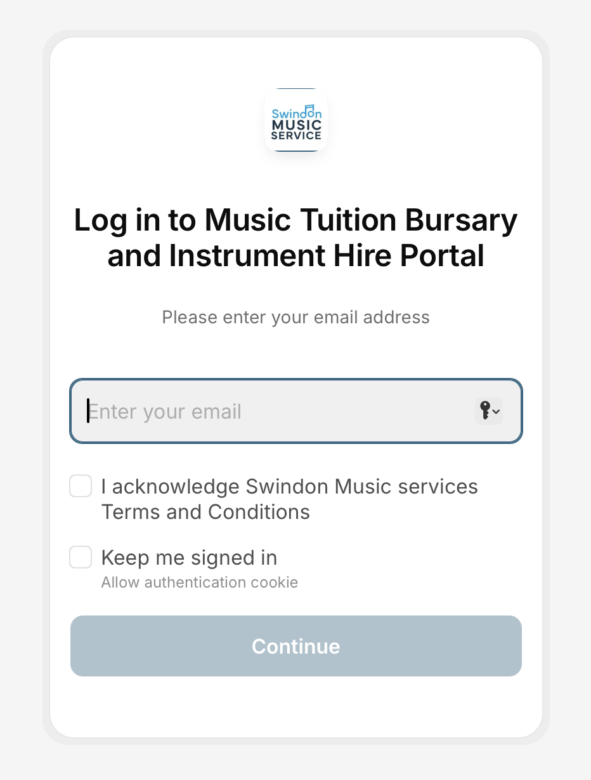
What’s on offer to schools?
How do I get on to the Portal?
If you do not currently have a login, either contact your local Music Cluster Coordinator, or email us on pclark@smscio.co.uk with the following information:
Name of your school requester
School email address for that named requester
Full name of your school
How do I know what cluster I’m in and who is the
Cluster Coordinator?
Visit our website page for Wiltshire School Clusters: https://gswmusichubswindwilts.org.uk/school-clusters-in-wiltshire/
https://wmc-subsidy-portal.glide.page
To access the Portal click here:

Slide 4
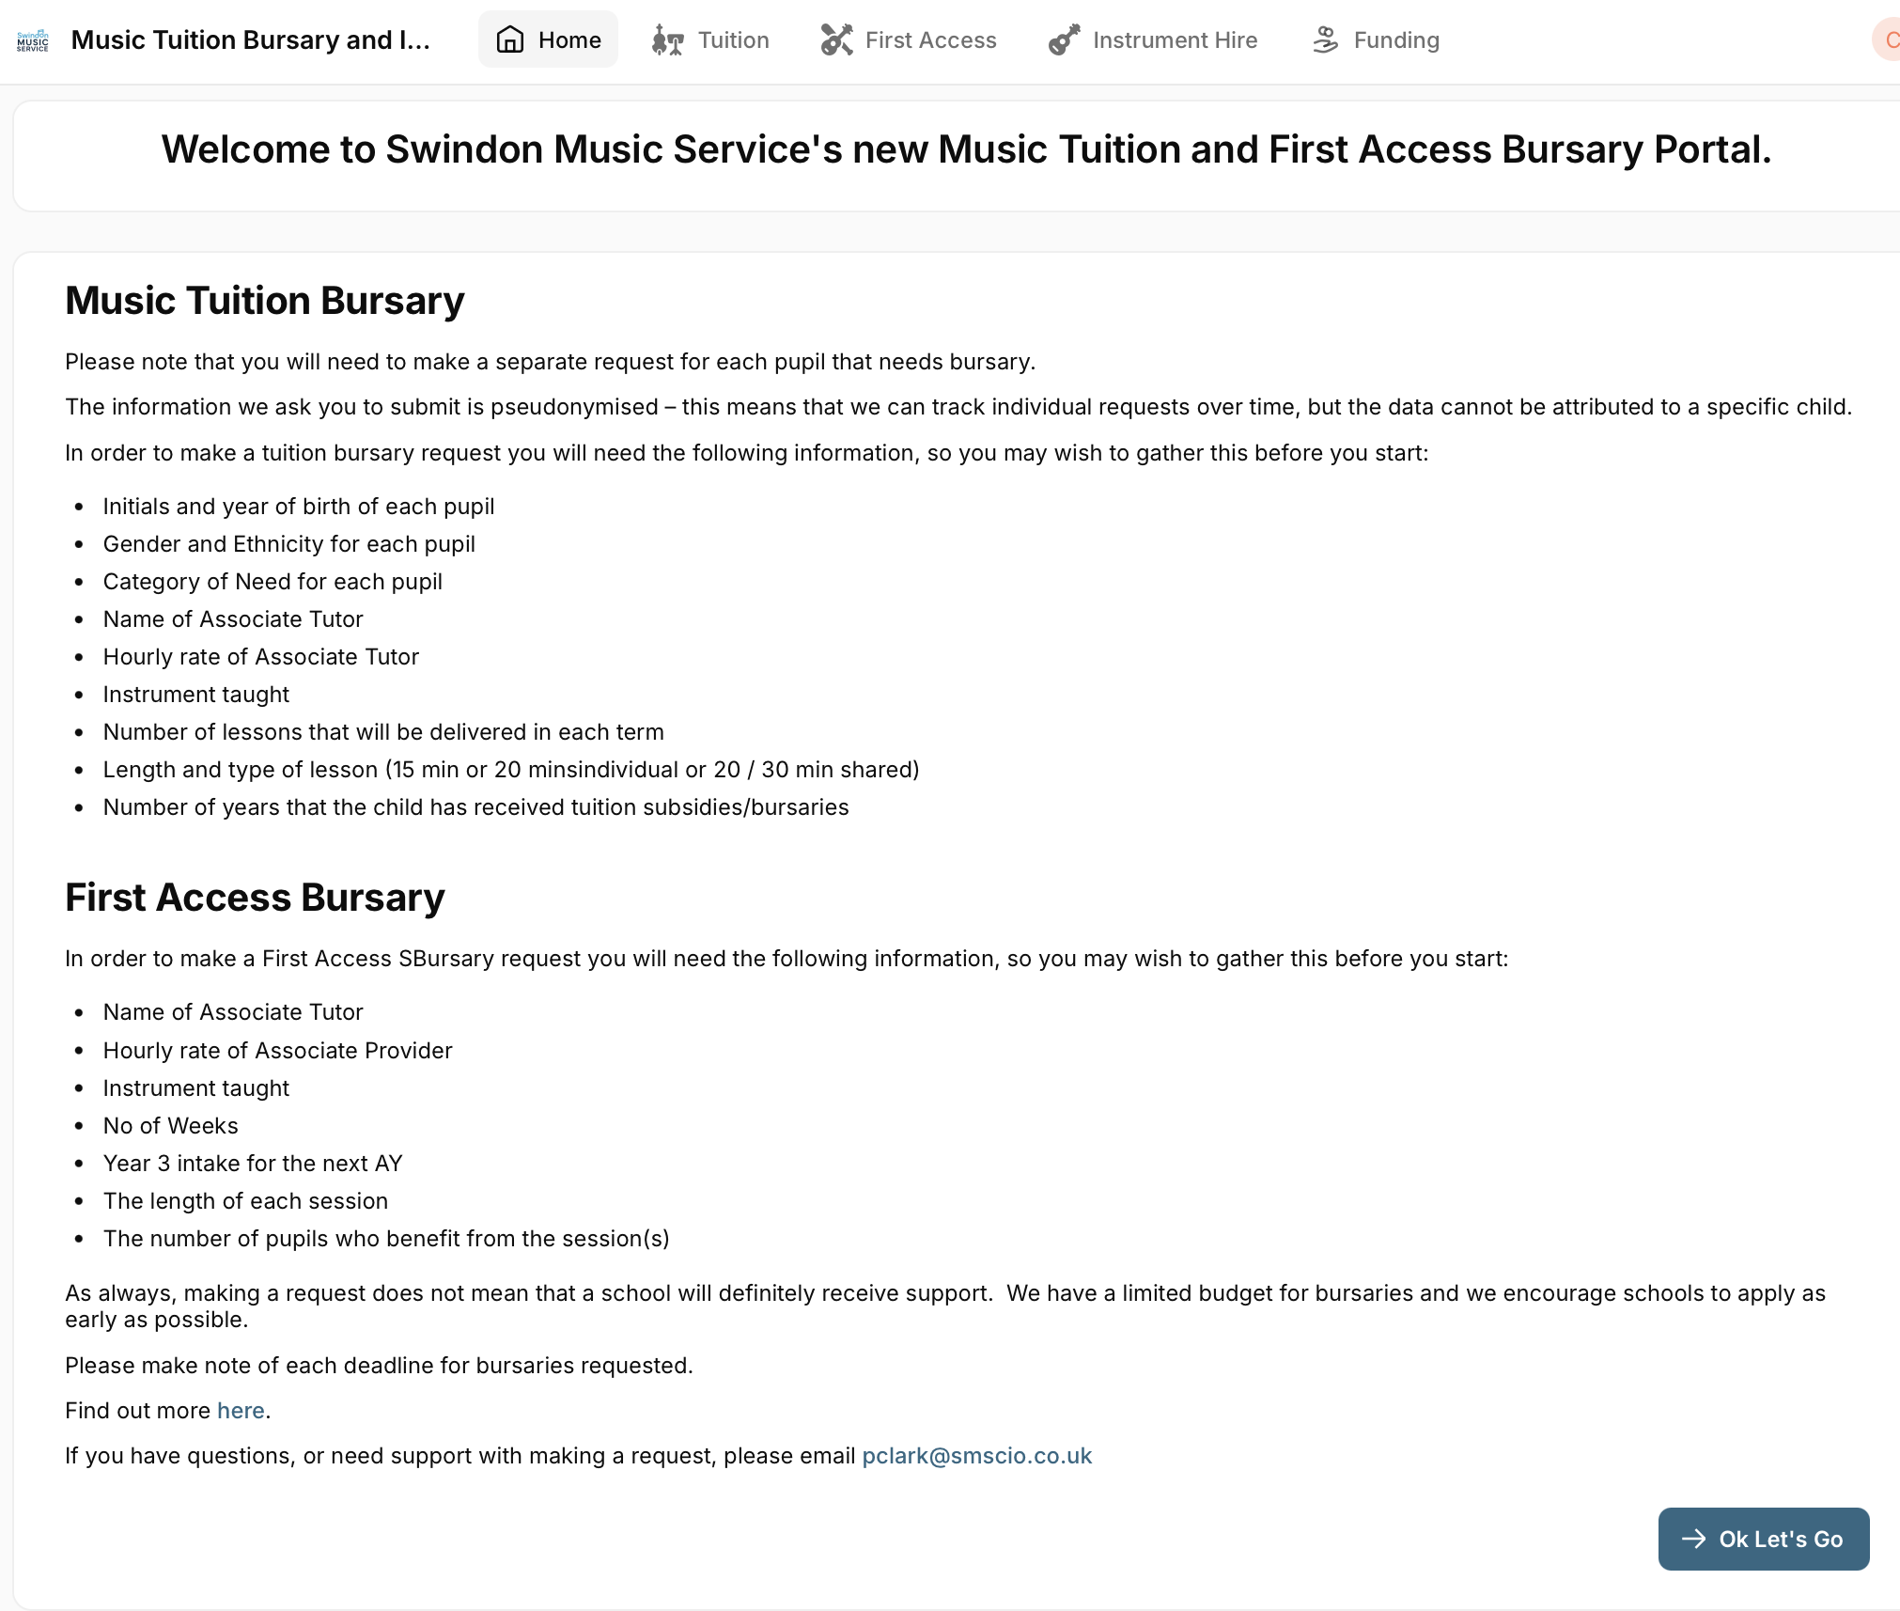
What’s on offer to schools?
Tuition Bursaries
Funding
First Access
Instrument Hire

Slide 5
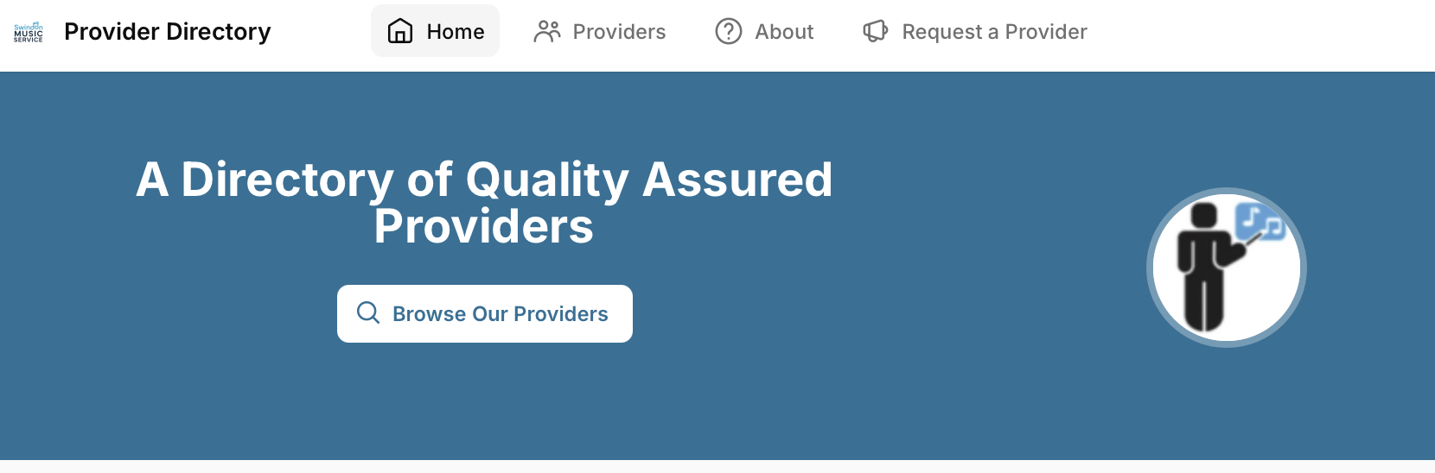
What’s on offer to schools?
Need to find an Associate tutor to teach your pupils in school?
Go to the Associate Directory HERE:
Click here
Easy to use tool to request an Associate tutor to teach in your school

Slide 6
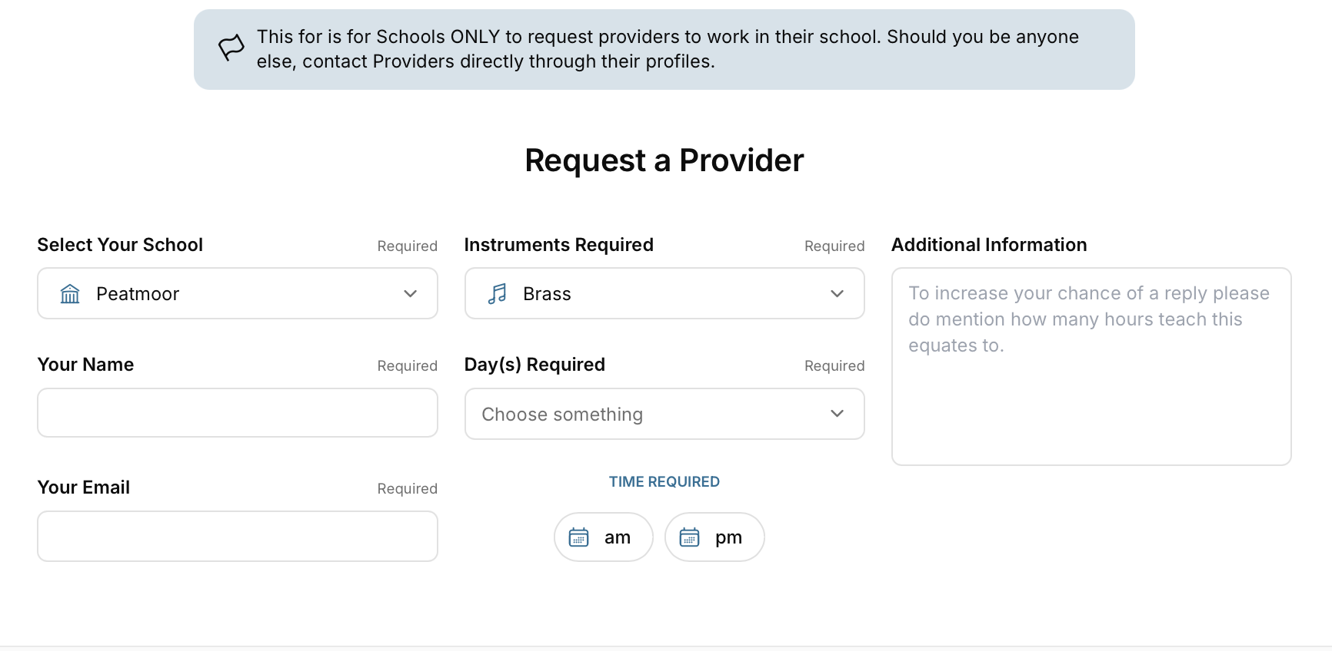
What’s on offer to schools?
Need to find an Associate tutor to teach your pupils in school?
Simply complete the form

Slide 7

New Grant D for Schools – for Primary schools
100 - £500 – (this is a revenue grant only)
Looking to start a choir of vocal group
Looking to start an instrumental Ensemble
Live Music Performance
Applications open in January
Applications open in January
Applications open in March
Assist with costs to buy in an Associate to help support setting up and supporting your music lead.
Assist with costs to buy in a singing associate to help prepare for the Hub’s School Voice Festivals
Assist with costs to buy in an Associate to help support setting up and supporting your music lead.
Help buy music resources (not instruments)
School Live Music Show
Associate showcase: demonstrations for potential tuition

Slide 8
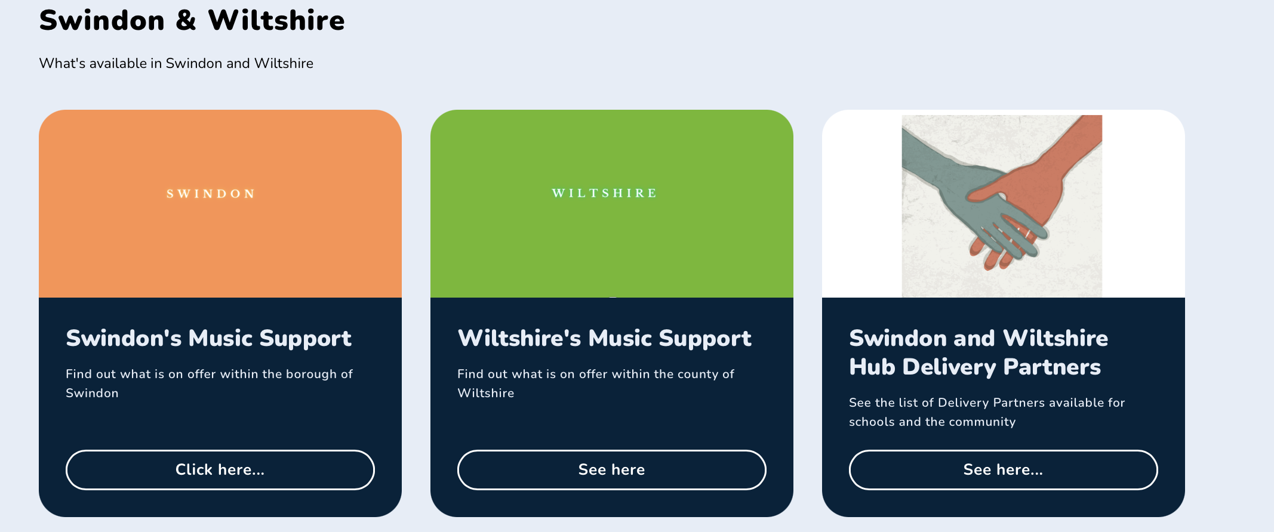
Use the website
Go to the website: HERE: https://gswmusichubswindwilts.org.uk
Click here

Slide 9
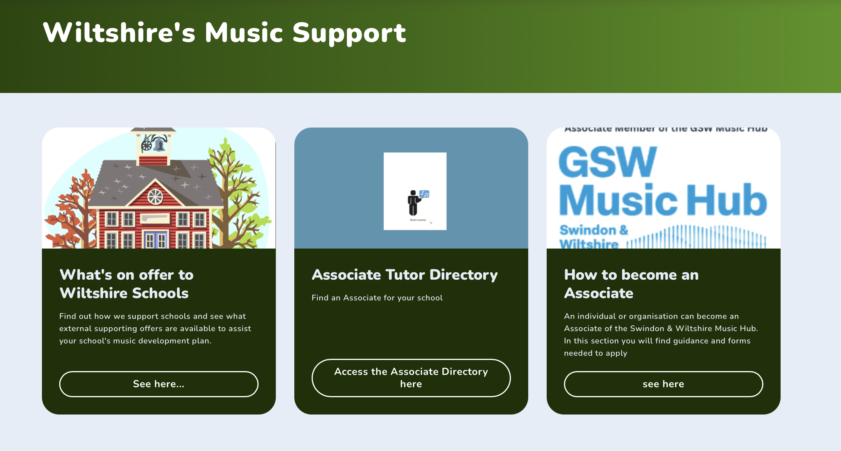

Use the website
Go to the website: HERE: https://gswmusichubswindwilts.org.uk
Click here – Live Bulletin Board
Click here

Slide 10

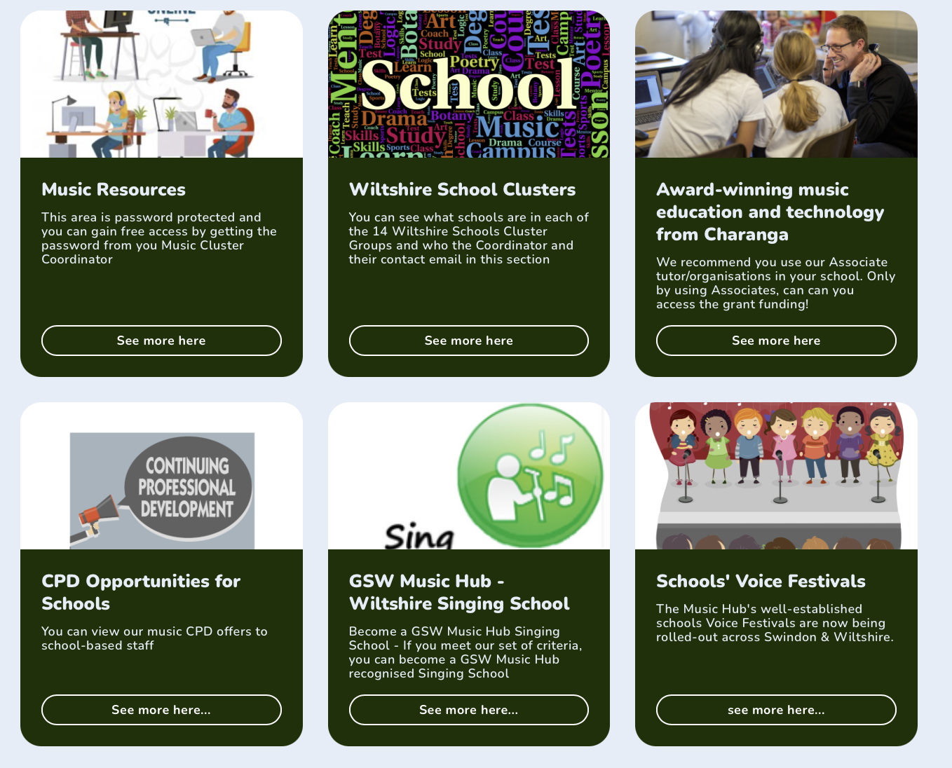
Use the website
Go to the website: HERE: https://gswmusichubswindwilts.org.uk

Slide 11
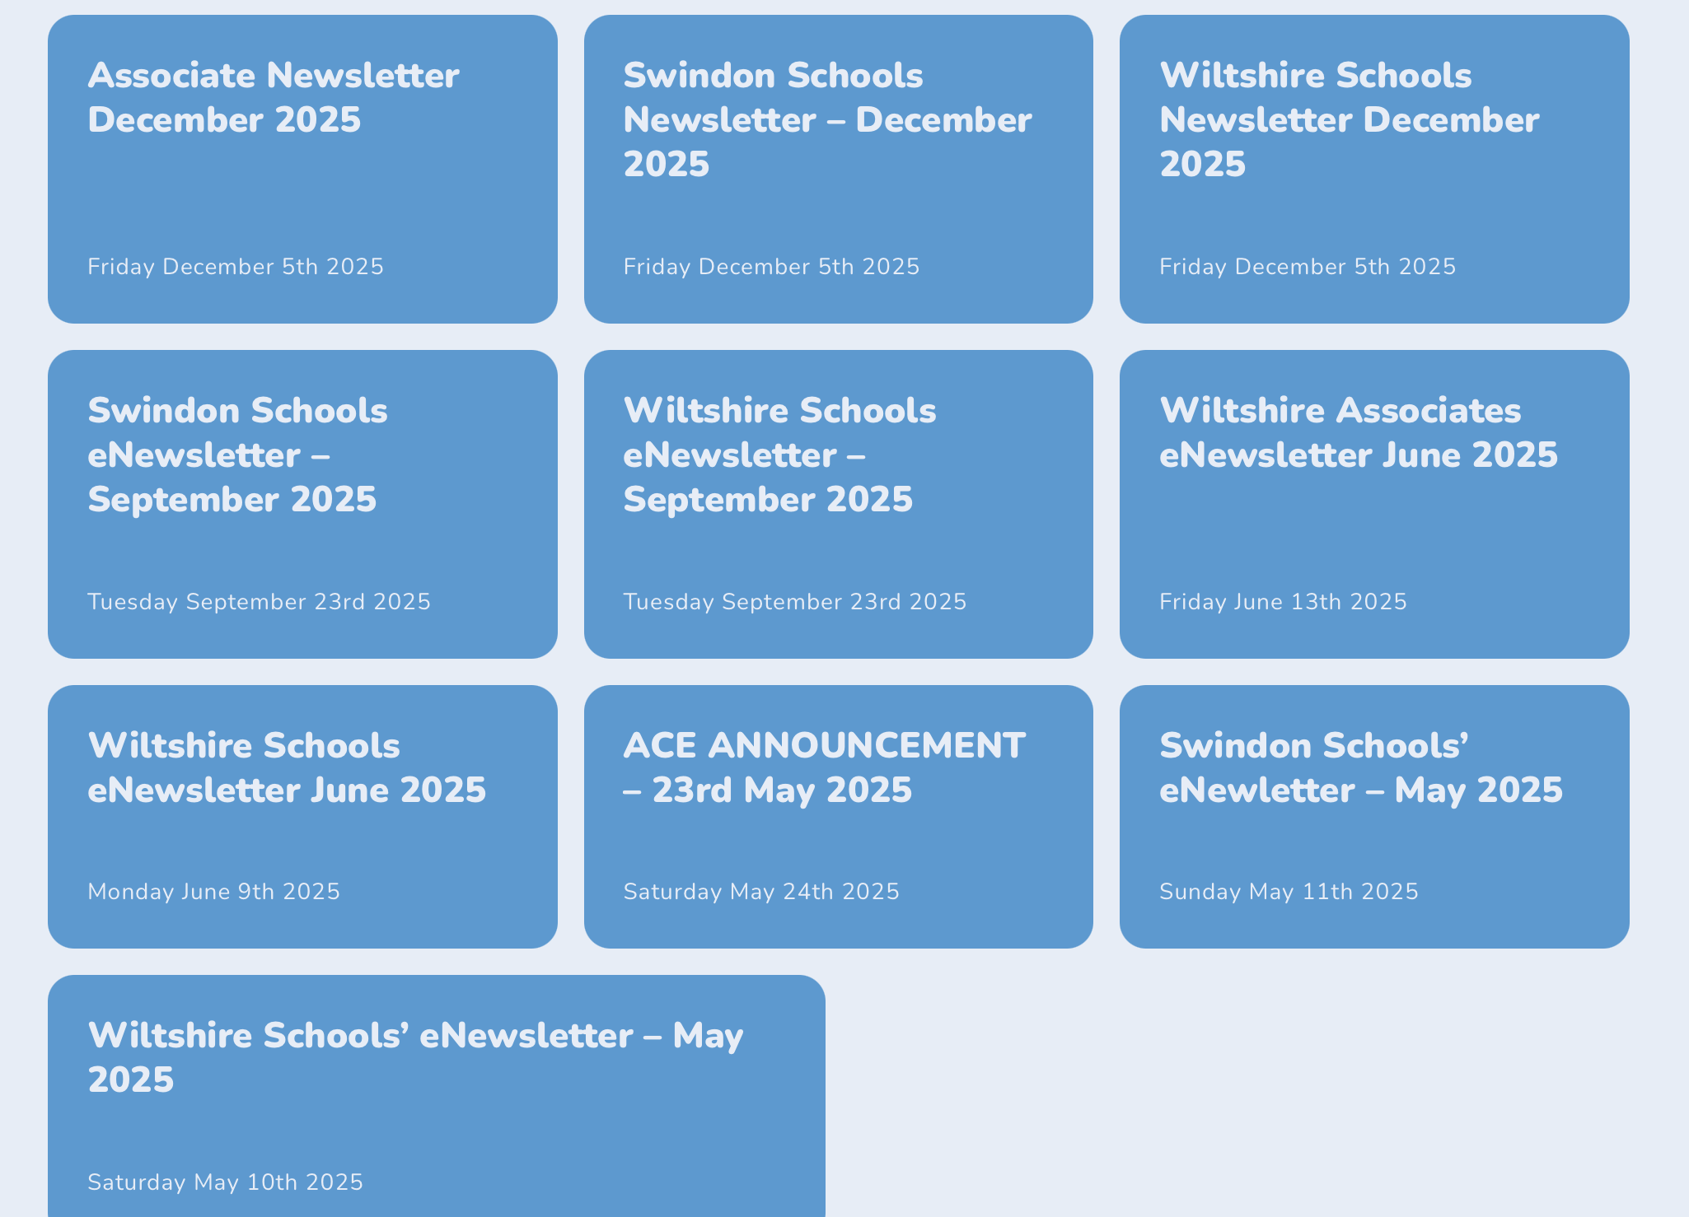
Archive eNewsletters
Bottom of the Home Page

Slide 12
Safeguarding
Wiltshire Council’s Safeguarding Team
Associates coming into your school
We have a formal partnership agreement with Wiltshire council’s safeguarding team
We hold monthly meeting to support the Associate scheme
Checks are a school’s responsibility as they as self-employed specialists
Ensure you see their original DBS certificate
What the Hub does
Undertakes QA and checks to allow them to become Associates
Holds a central register of all Associate individuals and organisations

Slide 13

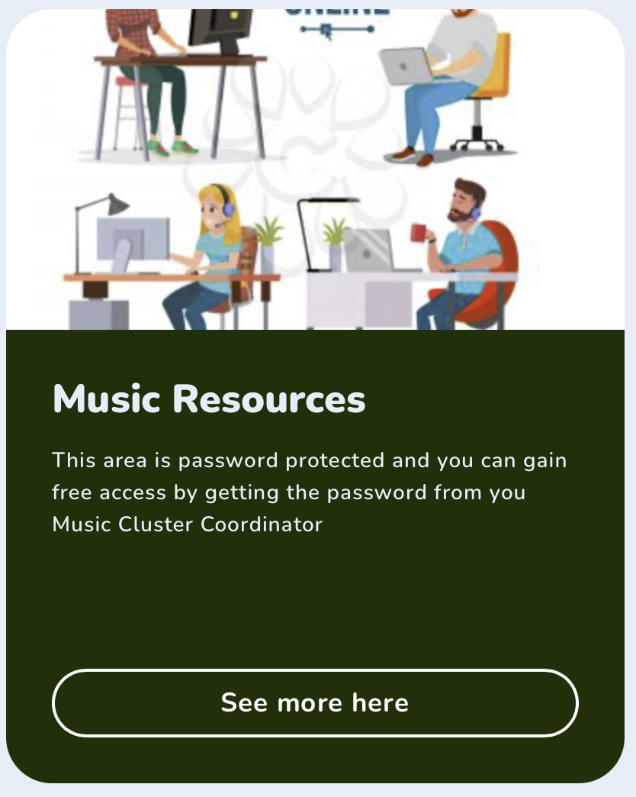
Use the website
Highlights for to Headteachers
https://gswmusichubswindwilts.org.uk/wp-content/uploads/2026/01/SMS-SAFEGUARDING-INFO-Working-with-music-tutors-Sept-2024-FINAL-2.pdf
https://gswmusichubswindwilts.org.uk/home/wiltshire/music-reources/

Slide 14
Contacts:
Cluster Coordinators: Not sure which cluster your school is in? See HERE
Devizes; North Wiltshire
Julia Falaki
falakij@smscio.co.uk
Calne & Melksham; Trowbridge
Emily Malcolm
malcome@smscio.co.uk
Chippenham; Marlborough & Pewsey
Steph Farr
farrs@smscio.co.uk
Amesbury; BoA & Corsham; Salisbury & Wilton; Warminster; Westbury
Emily Askew
askewe@smscio.co.uk
Downton; Tidworth
Louise Jordan
jordanl@smscio.co.uk
Mere & Tisbury
Lauren Lane
lanel@smscio.co.uk
Hub Support
CEO: Strategic Lead
Major (Retd) Peter Clark
pclark@smscio.co.uk
Deputy Head / Schools Manager
Lynn Hawkins
lhawkins@smscio.co.uk
Admin Support / Schools Assistant
Summer Scotford
sscotford@smscio.co.uk

